Slide 1
TITLE

Slide 2
Purpose of app
To help the patient manage the stress of remembering events and people at the events
To help the caretaker give the patient information about events and people who are attending.

Slide 3
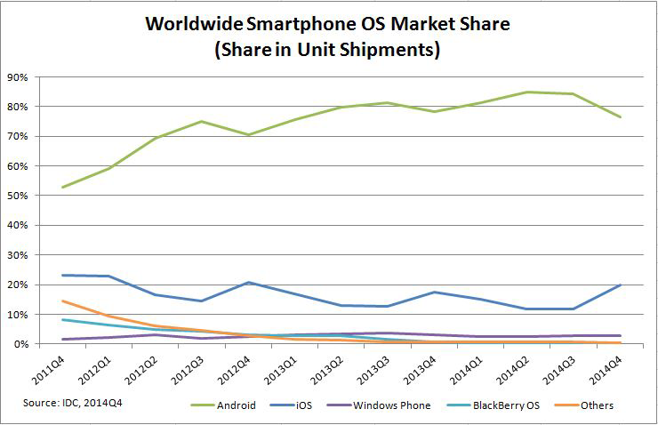

Slide 4
App Communication Model

Slide 5
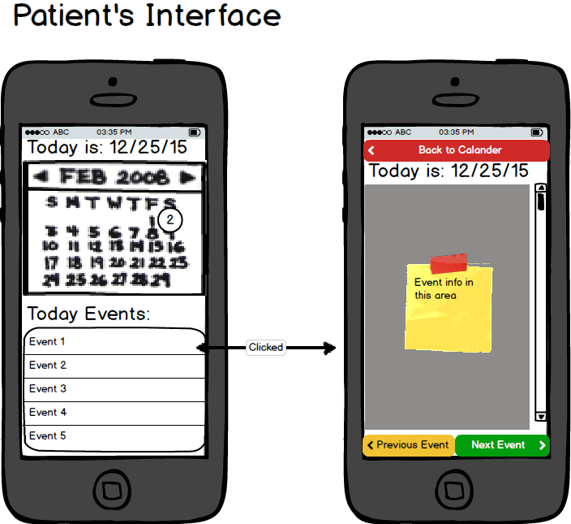
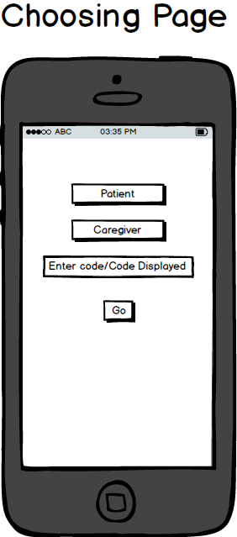
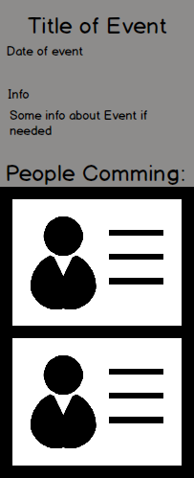
App Mockup

Slide 6
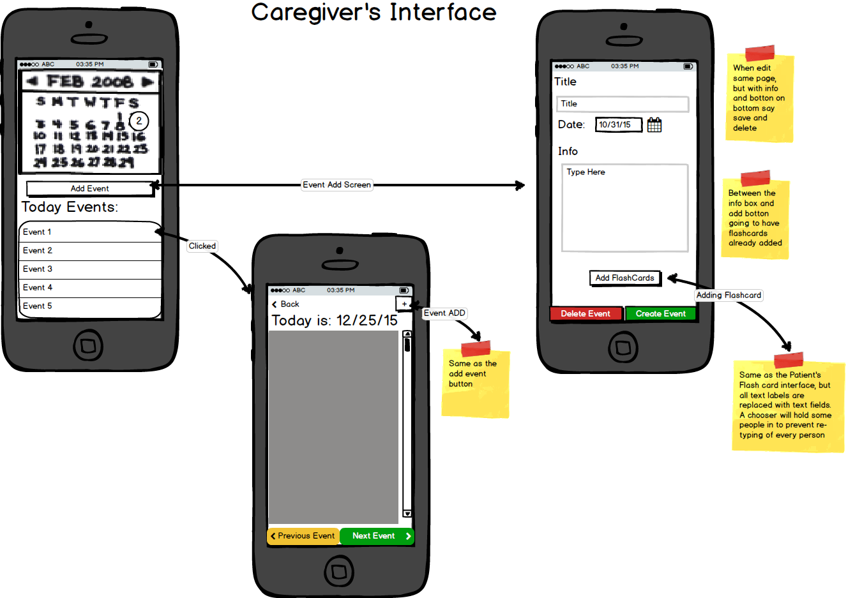
App Mockup

